Slide 1
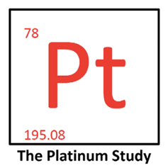
Long-term Survivorship in Testicular Cancer: The Platinum Study
Lois B. Travis, M.D., Sc.D.
Lawrence H. Einhorn Professor of Cancer Research
Indiana University Simon Comprehensive Cancer Center
May 31, 2024

Slide 2
Disclosures
I have no disclosures or conflicts of interest.
Notes:
2

Slide 3
Outline
Cisplatin and testicular cancer: importance
Survivorship and major treatment toxicities
Dose-response relationships
Cisplatin: per 100 mg/m²
Functional impairment
Summary
Notes:
3

Slide 4
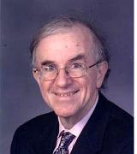
Cisplatin and Testicular Cancer Importance
Dr. Einhorn
Cure for metastatic solid cancer (1974, Dr. Lawrence Einhorn)
Platinating agents: most commonly used group of cytotoxic drugs worldwide - 5.8 million pts: cancers of colon, rectum, cervix, bladder, head/neck, lung, esophagus, breast, ovary, testis, thymoma, other
Testicular cancer: leading cancer in men age 18-39 years
10-year relative survival: 95%
Gain: 37.9 years of life (Li Urology, 2010)

Slide 5
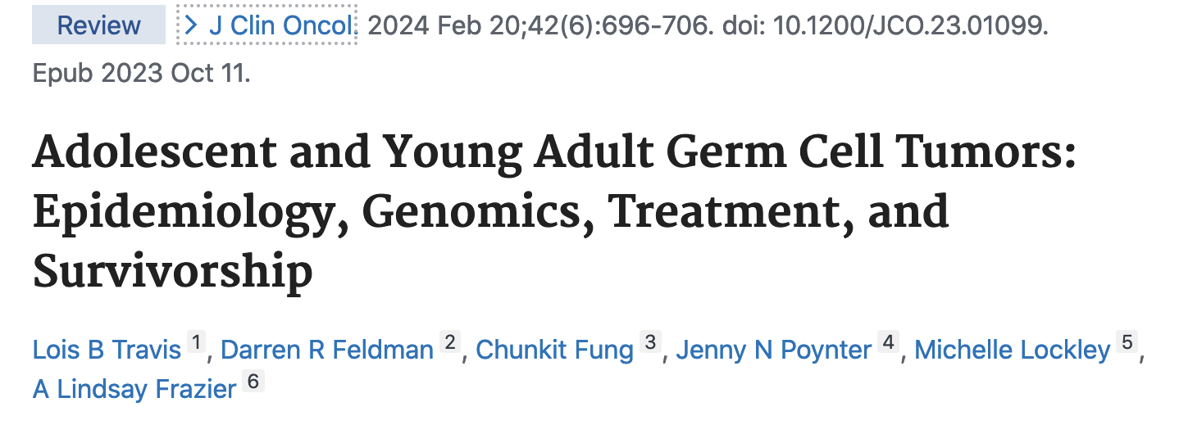
Late Effects of TC and Its Therapy
JCO 2024*
1. Second malignant neoplasms
Hearing loss, tinnitus → Functional impairment
Neuropathy; neuropathic pain
4. Renal, cardiovascular disease, pulmonary, others
Travis LB; Feldman, DR; Fung, C… Frazier AL. Adolescent and Young Adult Germ Cell Tumors: Epidemiology, Genomics, Treatment, and Survivorship. JCO 2024 Feb 20;42: 696-706.

Slide 6
Cisplatin: Carcinogenic Secondary Leukemias
Cisplatin for testicular cancer (36 leukemias, JNCI 2000)*
P trend for dose < 0.001 (median 5 yrs; range 1-17 yrs)
Absolute risk ~ 350 mg/m²: 16 excess leukemias per 10,000 patients followed for 15 years
Confirmed 1999 New Eng J Med report**
P-trend for dose < 0.001 (96 leukemias, median 3.3 yrs; range: 1-14 yrs)
High-dose etoposide (> 2.0 g/m²): leukemogenic
Cum. incid: 1.3% (95% CI 0.4% - 3.6%) (N=4, median: 52 mo; 1-17 yrs)^
Est. for < 2.0 g/m² ~ 0.6% (1995 JCO Review)^^
* Travis LB. J Natl Cancer Inst. 2000 Jul 19;92:1165-71. ** Travis LB. N Engl J Med 1999;340:351-7 (ovarian cancer). ^-Kollmannsberger Cl. JCO 1998;16:3386-91 (n=302 GCT); ^^ Bokemeyer C. JCO 1995; 13:283-292. For general overview of etoposide-related leukemias, see Zhang W Translational Oncology 2021: 101169.

Slide 7
Cisplatin: Carcinogenic Second Solid Cancers*
4,848 testicular cancer pts: 1976-2007, Netherlands
350 solid second malignant neoplasms (SMN); 99 GI; 50 CRC
Platinum vs. non-platinum HR = 2.4 (95% CI 1.6-3.6)
Colorectal SMN HR = 3.9 (95% CI 1.7-8.9)
Non-CRC GI SMN HR = 5.0 (95% CI 2.3-11)
Dose-dependent increase of all GI SMN (P trend < 0.001)
Per 100 mg/m² cisplatin HR = 1.5 (95% CI 1.3 – 1.8)
< 400 mg/m² HR = 2.3 (95% CI 0.7-7.6)
400-499 mg/m² HR = 3.6 (95% CI 1.6-8.3)
500+ mg/m² HR = 5.0 (95% CI 2.4-10)
*Groot, HJ et. al. Risk of Solid Cancer after Treatment of Testicular Germ Cell Cancer in the Platinum Era. JCO 2018 Aug 20;36:2504-2513.

Slide 8
The Platinum Study Overview
Goal: establish well-characterized clinical cohort of cisplatin-treated testicular cancer survivors for lifelong follow-up to evaluate cisplatin-related toxicities
Entry criteria
Age < 60 years at germ cell tumor diagnosis
First-line cisplatin-based chemotherapy
Routine follow-up at participating site

Slide 9
The Platinum Study Multi-Center Clinical Cohort
Princess Margaret Hospital
Dr. Robert Hamilton
Memorial Sloan Kettering
Dr. Darren Feldman
Indiana
Dr. Lois Travis
Dr. Larry Einhorn
Harvard – Dana Farber
Dr. Neil Young
Royal Marsden Hospital
Dr. Robert Huddart
M.D. Anderson
Dr. Jeri Kim
U. Pennsylvania
Dr. David Vaughn
U. Rochester
Dr. Chunkit Fung
British Columbia
Dr. Christian Kollmannsberger

Slide 10
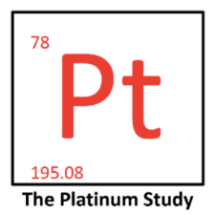
The Platinum Study Procedures
Eligible Patients
Questionnaire
Blood Specimen
Physical Exam
Extensive Audiometric Testing
Health Conditions
Lifestyle Factors
Prescription Meds
Genomic Studies
Cholesterol Panel n=500
Endocrine Studies n=500
Medical Records Review
GCT Diagnosis
GCT Treatment

Slide 11
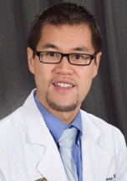
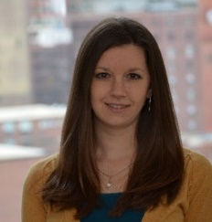
Cohort
Initial Demographics
Dr. Chunkit Fung
Dr. Sarah Kerns
Median age, germ cell tumor diagnosis: 31 years
Median age, clinical evaluation: 37 years
Median time since chemotherapy: 4.7 years
N ~ 1,911 at enrollment end (2018)
*Fung C J Clinical Oncol 2017, Kerns J Clinical Oncol 2018

Slide 12
Chemotherapy
Dr. Sarah Kerns
Cumulative Dose of
Cisplatin (mg/m²⁾
Type of Chemotherapy

Slide 13
Most Frequent Health Outcomes
 | Any | Grade 1 | Grade 2 | Grade 3 | Grade 4
Obesity | 868 (72%) | NA* | 506 (42%) | 315 (26%) | 47 (4%)
Peripheral sensory neuropathy | 683 (56%) | 344 (28%) | 176 (15%) | 163 (13%) | NA
Tinnitus | 481 (40%) | 304 (25%) | 86 (7%) | 91 (8%) | NA
Hearing loss | 476 (39%) | 297 (25%) | 164 (14%) | 15 (1.2%) | 0 (0%)
Raynaud phenomenon | 405 (33%) | 189 (16%) | 105 (9%) | 111 (9%) | NA
Erectile dysfunction | 345 (28%) | 193 (16%) | 152 (13%) | NA | NA
* NA, not applicable

Slide 14
Cumulative Burden of Morbidity (CBM) Results
68.7%
68.7%
20.0%
8.3%
20.0%
2.5%
0.5%
8.3%
0.5%

Slide 15
Relationship of CBM with Platinum Dose Restricted to Cisplatin-Related Toxicities*
 | Odds Ratio (95% CI)** | P-value
Cumulative cisplatin dose (per 100 mg/m²) | 1.29 (1.09 – 1.52) | 0.003
* Includes peripheral sensory neuropathy, hearing loss, tinnitus, and chronic renal disease
** Adjusted for age at evaluation and bleomycin use

Slide 16
Multivariate Model Factors Related to CBM Score
 | Odds Ratio (95% CI) | P-value
Age at evaluation (per 5 years) | 1.18 (1.10-1.26) | <0.001
Asian (vs. white) | 0.41 (0.23-0.72) | 0.002
Less than college education (vs. college or post college) | 1.44 (1.11-1.87) | 0.006
On disability leave (vs. employed) | 3.53 (1.57-7.95) | 0.002
Current or former smoking (vs. never) | 1.28 (1.02-1.63) | 0.037
Vigorous physical activity (yes vs. no) | 0.68 (0.52-0.89) | 0.004
EPx4 (vs. BEPx3) | 1.09 (0.75-1.60) | 0.650
BEPx4 (vs. BEPx3) | 1.44 (1.04-1.98) | 0.028
VIPx4 (vs. BEPx3) | 1.96 (1.04-3.71) | 0.039
*From Kerns S, Fung C…Travis LB. J Clin Oncol 2018.

Slide 17
Comprehensive Audiometry*
JCO 2016
Dr. Robert Frisina
80% pts: ASHA-defined hearing loss
Stat. significant relationships between cumulative cisplatin dose and hearing loss at each of 4, 6, 8, 10, 12 kHz
Every 100 mg/m² increase in cumulative cisplatin dose: 3.3-dB decline in overall hearing threshold (4-12 kHz, P < 0.001)
Tinnitus: 40% patients; related to reduced hearing thresholds (P < 4.9 X 10⁻⁹)
*Frisina, Wheeler …Travis: J Clin Oncol, 8/10/16 with Editorial – includes first 488 enrolled patients. ASHA, American Speech Language Hearing Association.

Slide 18
Comprehensive Audiometry*
JCO 2016 and 2023
Dr. Robert Frisina
1 in 5: severe-to-profound ASHA-defined hearing loss (HL)
Lifetime costs to society for person with severe-to-profound HL (onset age 18-44): about $453,000**
Other risk factors
Hypertension (P = 0.007)
Current or ever smoking (P = 0.079 and 0.095, respectively)
Audiometric and self-reported HL are correlated (P < 0.001)***
*Frisina: J Clin Oncol, 2016 with Editorial – includes first 488 enrolled patients. ASHA, Amer. Speech Language Hearing Assoc. **Most costs (67%) due to reduced work productivity (Mohr PE 2000). *** Sanchez JCO 2023.

Slide 19
Self-Reported Hearing Loss, Tinnitus
Risk Factors
Dr. Robert Frisina
Self-reported hearing loss (HL)*
Dose-dependent: RR = 1.9/100 mg/m² cisplatin (P < 0.05)
Hypercholesterolemia: OR = 3.5; P=0.007
Family history of HL < age 60: OR = 2.9; P=0.07
Tinnitus**
Dose-dependent: RR = 1.4/100 mg/m² cisplatin (P = 0.007)
400 vs 300 mg/m² (OR = 1.14; P < 0.05)
> 400 mg/m² (OR = 2.6; P < 0.05)
*Sanchez Frisina JCS 2023. Self-reported HL. N=145, longitudinal study. **El-Charif Travis Dolan CCR 2019 (N=762)

Slide 20
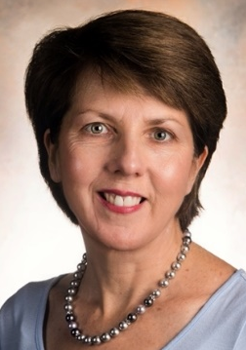
Tinnitus
Multivariate Analyses
Dr. Eileen Dolan
Hypercholesterolemia: OR = 1.8; 95% CI 1.1-2.8
Hypertension: OR = 2.6; 95% CI 1.7-4.0
Modifiable risk factors
Chronic smoking: OR = 2.0; 95% CI 1.2-3.3
Current smoking: OR = 1.6; 95% CI 1.02-2.6
Noise exposure: OR = 1.5; 95% CI 1.1-1.8
Zhang X, et.al. Pharmacogenomics of Cisplatin-Induced Neurotoxicities: Hearing Loss, Tinnitus and Peripheral Sensory Neuropathy. Cancer Medicine, 11: 2801-2816, 2022. N= 1,680 patients.

Slide 21
Neuropathy
Multivariate Analyses
Dr. Eileen Dolan
Modifiable risk factors
Excess drinking: OR = 1.4; 95% CI 1.4-1.9
Current smoking: OR = 2.1; 95% CI 1.5-2.9
Hypertension: OR = 1.9; 95% CI: 1.4-2.5
Associated with weight gain since testicular cancer diagnosis (P=0.004)
Zhang X, Dolan. Pharmacogenomics of Cisplatin-Induced Neurotoxicities: Hearing Loss, Tinnitus and Peripheral Sensory Neuropathy. Cancer Medicine, 11: 2801-2816, 2022. 1,680 patients. No relationship with cisplatin dose (limited range.) Weight gain reference: Dolan 2017.

Slide 22
The Platinum Study
Phase II
Dr. Lawrence Einhorn
Longitudinal follow-up
Additional adverse health outcomes (neuropathic pain)
Repeat audiometry
Evaluate toxicity-related functional impairment

Slide 23
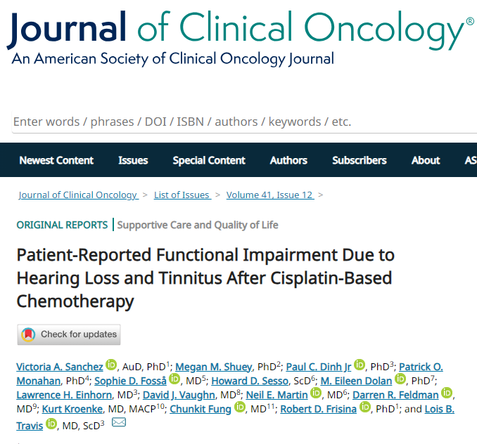
2023 Ototoxicity: Functional Impairment
Patient-reported functional impairment due to cisplatin-related hearing loss and tinnitus not evaluated
Goal: Quantify extent of impairment with validated, otologic-specific patient-reported outcomes
In what percent of patients is functional impairment clinically actionable?
Sanchez/Shuey, Dinh … Einhorn... Frisina, Travis: J Clin Oncol. Jan 10, 2023

Slide 24
Functional Impairment
JCO 2023
Dr. Robert Frisina
Hearing Handicap Inventory for Adults (HHIA)
Tinnitus Primary Frequency Questionnaire (TPFQ)
Extensively validated, used worldwide in multiple languages – Spanish, Arabic, Chinese, Korean, many others
25 questions (HHIA); 20 questions (TPFQ)
Example: “Does a hearing problem cause you to feel depressed?” “I lie awake at night because of my tinnitus.”

Slide 25
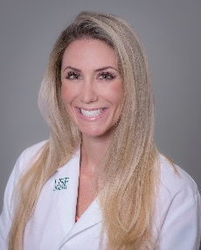
HHIA and TPFQ
Scoring and Clinical Categories
Dr. Vicky Sanchez
Dr. Robert Frisina
Range: 0% (no handicap) to 100% (greatest handicap)
0-16%: None/minimal handicap
17-42%: Mild/moderate handicap*
43-100%: Severe handicap*
Mild/moderate or severe: clinically actionable
Referred for audiologic evaluation/treatment
1/3 of survivors scored here

Slide 26
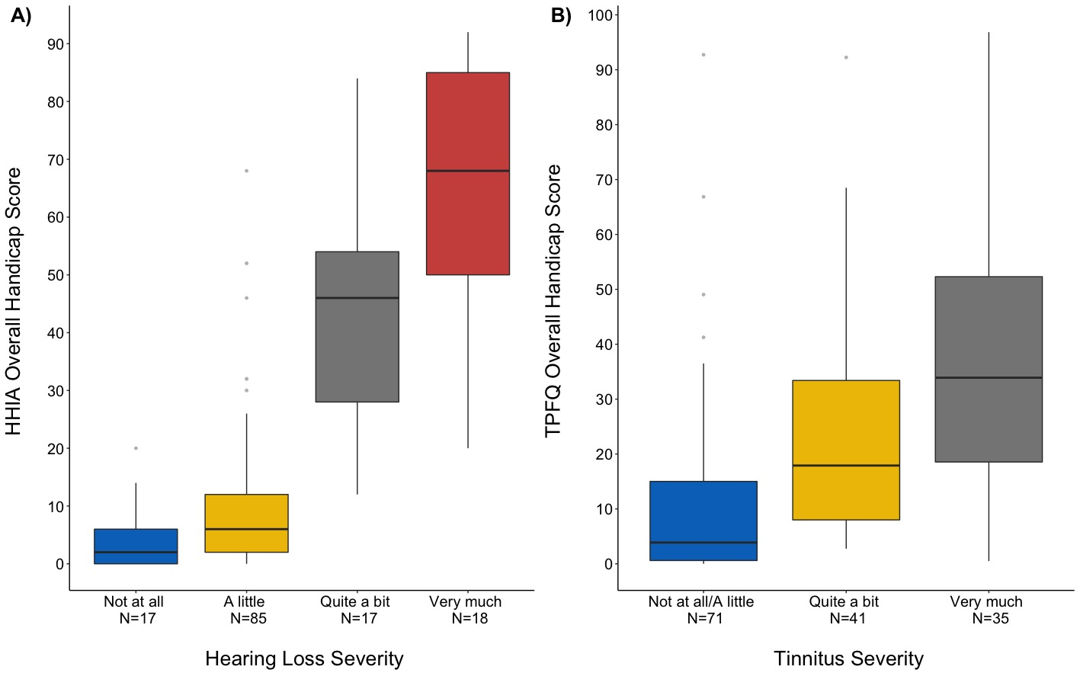
2023 Hearing Loss Findings (JCO)
“Severe” functional impairment due to hearing loss:
Cognitive dysfunction: OR=10.6 (P<0.001)
Fatigue: OR = 5.5 (P=0.003)
Overall health: OR = 0.19 (P=0.012)
Depression: OR = 2.0 (P=0.21)
Anxiety: OR = 1.9 (P=0.29)
Correlation between HL Severity and HHIA Handicap (P < 0.001)
Sanchez/Shuey, Dinh,… Einhorn... Frisina, Travis: J Clin Oncol. Jan 10, 2023.
Notes:
HL-related ‘listening fatigue”
Increased cognitive load, extra effort to process speech → deplete cognitive reserve → fatigue
Hearing aids: reduce listening fatigue, depression; improve communication, cognition
Untreated hearing loss in general population
Single largest modifiable risk factor for cognitive decline and dementia
Hearing aids: 10% patients (JCO 2023)

Slide 27
2023 Tinnitus Findings (JCO)
“Severe” functional impairment due to tinnitus:
Cognitive dysfunction: OR = 12.6 (P<0.001)
Fatigue: OR = 7.2 (P=0.002)
Overall health: OR = 0.15 (P=0.007)
Depression: OR = 2.8 (P=0.095)
Anxiety: OR = 1.8 (P=0.32)
Correlation between Tinnitus Severity and TPFQ Handicap (P<0.001)
Sanchez/Shuey, Dinh,… Einhorn... Frisina, Travis: J Clin Oncol. Jan 10, 2023.
Notes:
Tinnitus: affects 10-15% adults worldwide
Severity key; increasing severity strongly related to adverse health outcomes
Only 3-5% adults suffer with tinnitus
Neuroimaging; different brain activity and connectivity patterns for pts with severe tinnitus
Suffering with tinnitus → social isolation, increased stress; extreme cases, suicide
Ear and Hearing 2022: TCS with tinnitus 2- to 3-fold more likely to use prescription medications for anxiety/depression (P < 0.05)
Tinnitus: no medicinal therapies (instead cognitive behavioral therapy)
For pts with hearing loss and tinnitus, hearing aids may reduce tinnitus
JCO 2023: overall ~ 1/3 pts with hearing loss had mild/moderate or severe handicap (clinically actionable) → referred for audiologic evaluation/intervention in general practice

Slide 28
Functional Impairment
JCO 2023: Bottomline
Dr. Vicky Sanchez
Ototoxicity impacts patients
1 in 3 survivors with hearing loss had clinically significant functional impairment attributed to hearing loss
44% survivors with tinnitus had clinically significant functional impairment attributed to tinnitus

Slide 29
Functional Impairment
Hearing Loss
Dr. Vicky Sanchez
Hearing loss → increased cognitive load, extra effort to process speech → depletes cognitive reserve → fatigue
Hearing aids: 10% of patients (JCO 2023)
Could reduce listening fatigue, depression; improve communication and cognition
Untreated hearing loss in general population
Single largest modifiable risk factor for cognitive decline/dementia* (others: diabetes, obesity, tobacco use)
Livingston et al. Dementia Prevention, Intervention, and Care: 2020 Report of the Lancet Commission. The Lancet 396:413-446, 2020

Slide 30
Cisplatin-related Ototoxicity
Importance: JCO 2023*
JCO Associate Editor, Dr. Michael Carducci: “Attention to survivor issues such as hearing loss after platinum treatment … essential and includes follow-up with audiology, patient education, and thorough survivorship plans highlighting the impact of hearing loss.”
Recommendation: administer HHIA and TPFQ to patients with hearing loss or tinnitus after cisplatin-based chemotherapy
For those with clinically actionable scores, refer to audiologists for evaluation
* Sanchez, VA et. al. Patient-Reported Functional Impairment Due to Hearing Loss and Tinnitus After Cisplatin-Based Chemotherapy. JCO 2023 Apr 20;41:2211-2226

Slide 31
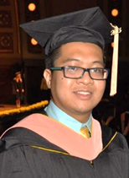
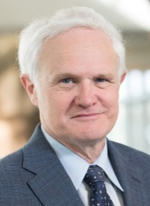
Longitudinal Follow-up Overview (JNCI 2024)
Dr. Paul Dinh
Dr. Kurt Kroenke
Median age: 46 years (IQR: 38-53)
Median time since chemo.: 10.7 years (IQR: 7.2-16.0 yrs)
Median no. adverse health outcomes (AHO): 5 (IQR: 3-7)
12% TCS: ≥ Ten AHOs
Increasing numbers of AHOs → decreases in mental and physical health (P < 0.0001 each)
Dinh PC, Monahan ... Nevel/Kroenke/Einhorn … Impact of Pain And Adverse Health Outcomes on Long-term U.S. Testicular Cancer Survivors. J Natl Cancer Inst. 2024 Mar 7;116:455-467. 358 patients
Notes:
31

Slide 32
Types of AHOs JNCI 2024
Dr. Patrick Monahan
Dr. Paul Dinh
Adverse Health Outcomes | Total (N=358)
Tinnitus | 218 (61%)
Peripheral sensory neuropathy | 206 (58%)
Hearing loss | 202 (56%)
Raynaud Phenomenon | 154 (43%)
Chemotherapy-induced neuropathic pain | 69 (19%)
Problems with balance/equilibrium/reach | 34 (7%)
Hypercholesterolemia | 132 (37%)
Hypertension | 103 (29%)
Notes:
32

Slide 33
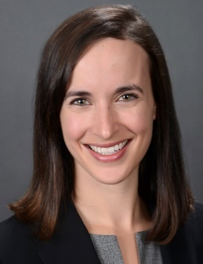
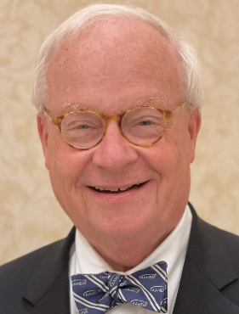
Neuropathic Pain
Dr. Kathryn Nevel
Dr. John Kincaid
One in 5 patients
Significantly impacted mental health (P < 0.001)
Caused functional impairment (PROMIS Pain Interference questions)*
What worsened impairment?
Location in feet/toes (vs. hands/fingers)
Peripheral artery disease
Severity of sensory neuropathy
*PROMIS: "How much did pain … interfere with your day-to-day activities? …. with your social activities? … etc. "

Slide 34
Neuropathic Pain Recommendations
Dr. Kathryn Nevel
Dr. John Kincaid
No agents approved to prevent neuropathy*
Moderate recommendation for duloxetine to treat neuropathic pain*
Refer to neurologists and pain specialists as needed
* Loprinzi CL, et al. Prevention and Management of Chemotherapy-Induced Peripheral Neuropathy in Survivors of Adult Cancers: ASCO Guideline Update. JCO 2020; 38:3325-3348. Per Dr. Einhorn, 4/2024: Gabapentin, Pregabalin can help with burning painful neuropathy, but not sensory changes.

Slide 35
Summary Major Points - 1
Cisplatin: cornerstone of therapy for germ cell tumors
Major dose-dependent toxicities
Leukemias (small absolute risk)
Solid tumors (especially gastro-intestinal)
Hearing loss (HL), tinnitus
Risks per 100 mg/m² of cisplatin
All GI cancers: HR = 1.5 (95% CI: 1.3-1.8) (P trend < 0.001)
Self-reported HL: RR = 1.9 (P trend < 0.05)
Audiometric HL: 3.3 dB decline (P trend = 0.001)
Tinnitus: RR = 1.4 (P trend = 0.007)
CBM-Platinum score: OR = 1.23 (P trend = 0.003)
Notes:
35

Slide 36
Summary Major Points - 2
Co-morbidities and modifiable risk factors influence risk of cisplatin-related toxicities
Hearing loss: tobacco use, hypertension, hypercholesterolemia
Tinnitus: tobacco use, noise exposure, hypertension, hypercholesterolemia
Neuropathy: excess drinking, tobacco use, hypertension
HL, tinnitus, neuropathic pain associated with functional impairment, but can be recognized and managed
Avoiding platinum not an option, but can mitigate some secondary outcomes
Notes:
36

Slide 37
Acknowledgments Investigators
USF: Drs. Vicky Sanchez, Robert Frisina
U of Chicago: Dr. M. Eileen Dolan
IU: Drs. Paul Dinh, Patrick Monahan, Kathryn Nevel, John Kincaid, Kurt Kroenke, Lawrence Einhorn
MSKCC and Harvard: Drs. Darren Feldman and Howard Sesso
Oncologists: Drs. Chunkit Fung (URMC), David Vaughn (U. Penn), Neil Martin (Harvard-DFCI), Christian Kollsmannsberger (BCCA), Rob Hamilton (PMH), Robert Huddart (RMH)
Vanderbilt: Drs. Megan Shuey, Nancy Cox

Slide 38
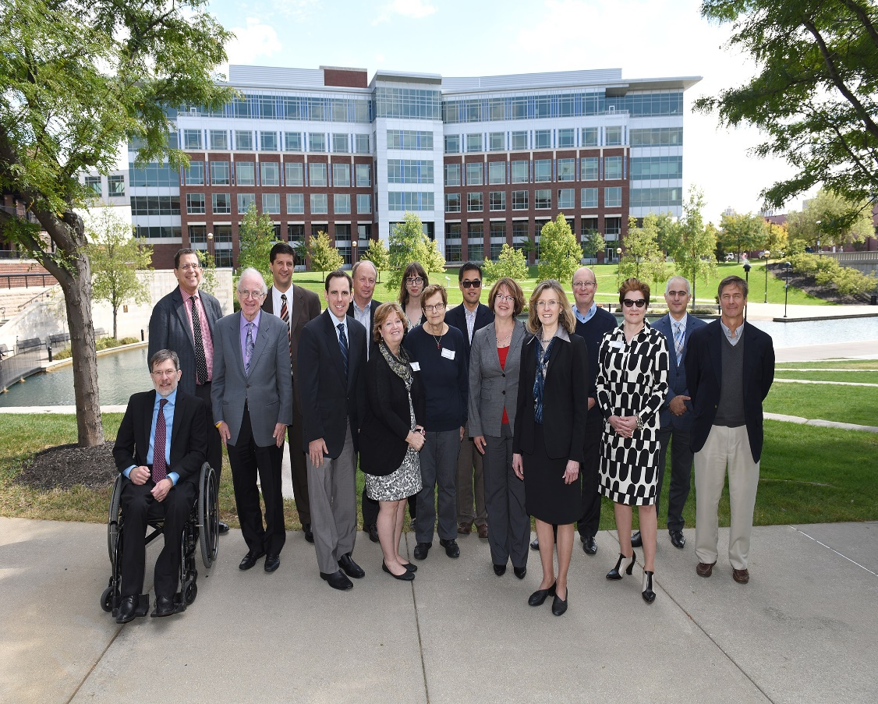
Thank You This is Survivorship Team Science
We are indebted to our patients and the NCI DCCPS for support of 2 R01 CA157823.

